Slide 1
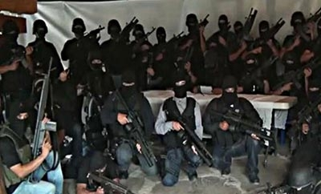

The Network Science Behind
Organized Crime In Mexico
Social Network Analytics DNSC 4233-10
Connor Rodgers, Xinyu Li, Marissa Lumnah,
Jackson Pentecost, Ambuja Sharma, and Matthew Wolf

Slide 2
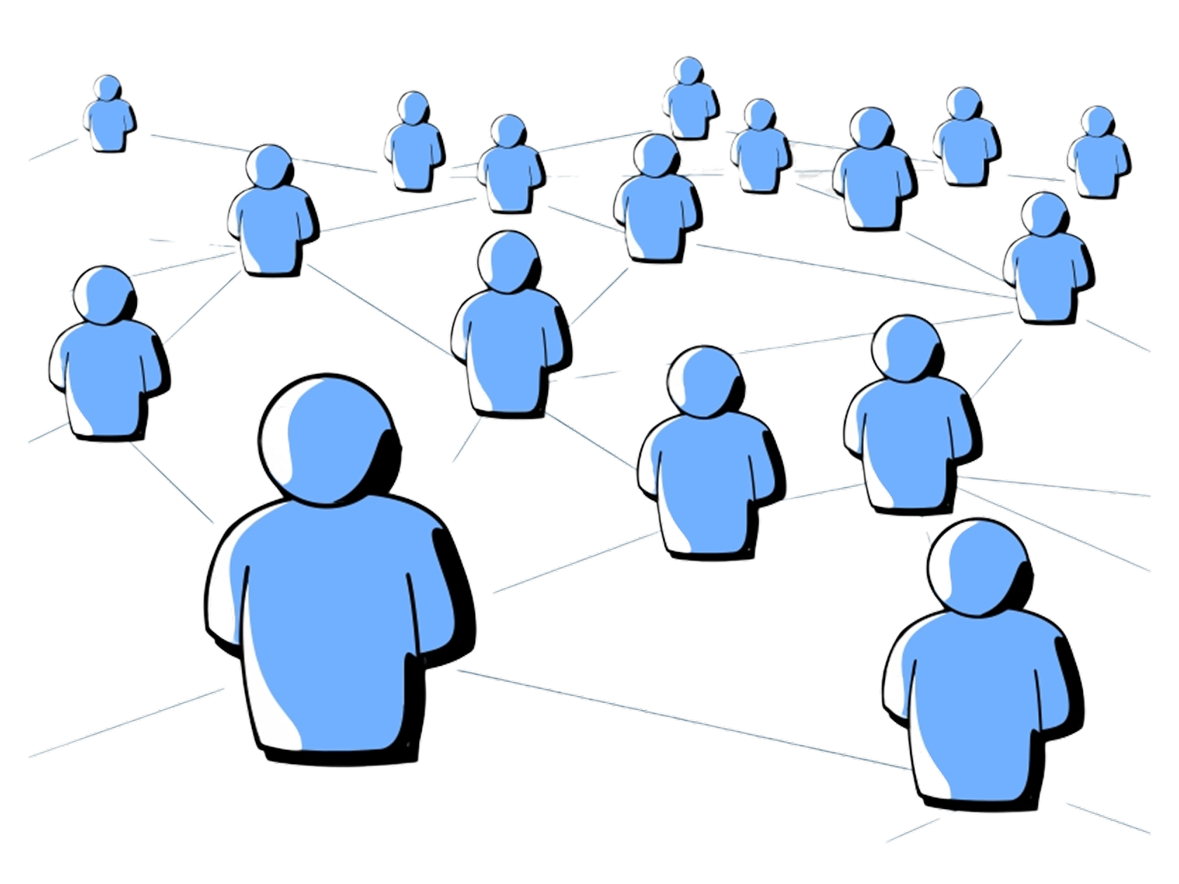
Executive Summary
Data Collection:
Organized crime in Mexico has evolved into a complex system of alliances and rivalries
Analyze a network dataset that captures these relationships in the year 2020, where nodes represent cartel groups and edges denote either alliances or rivalries
Research Questions:
Which cartels are the most structurally influential in Mexico, and does it differ between alliances and rivalries?
What network indicators are most predictive of cartel violence or instability?
How does structural power correlate with crime rates?

Slide 3
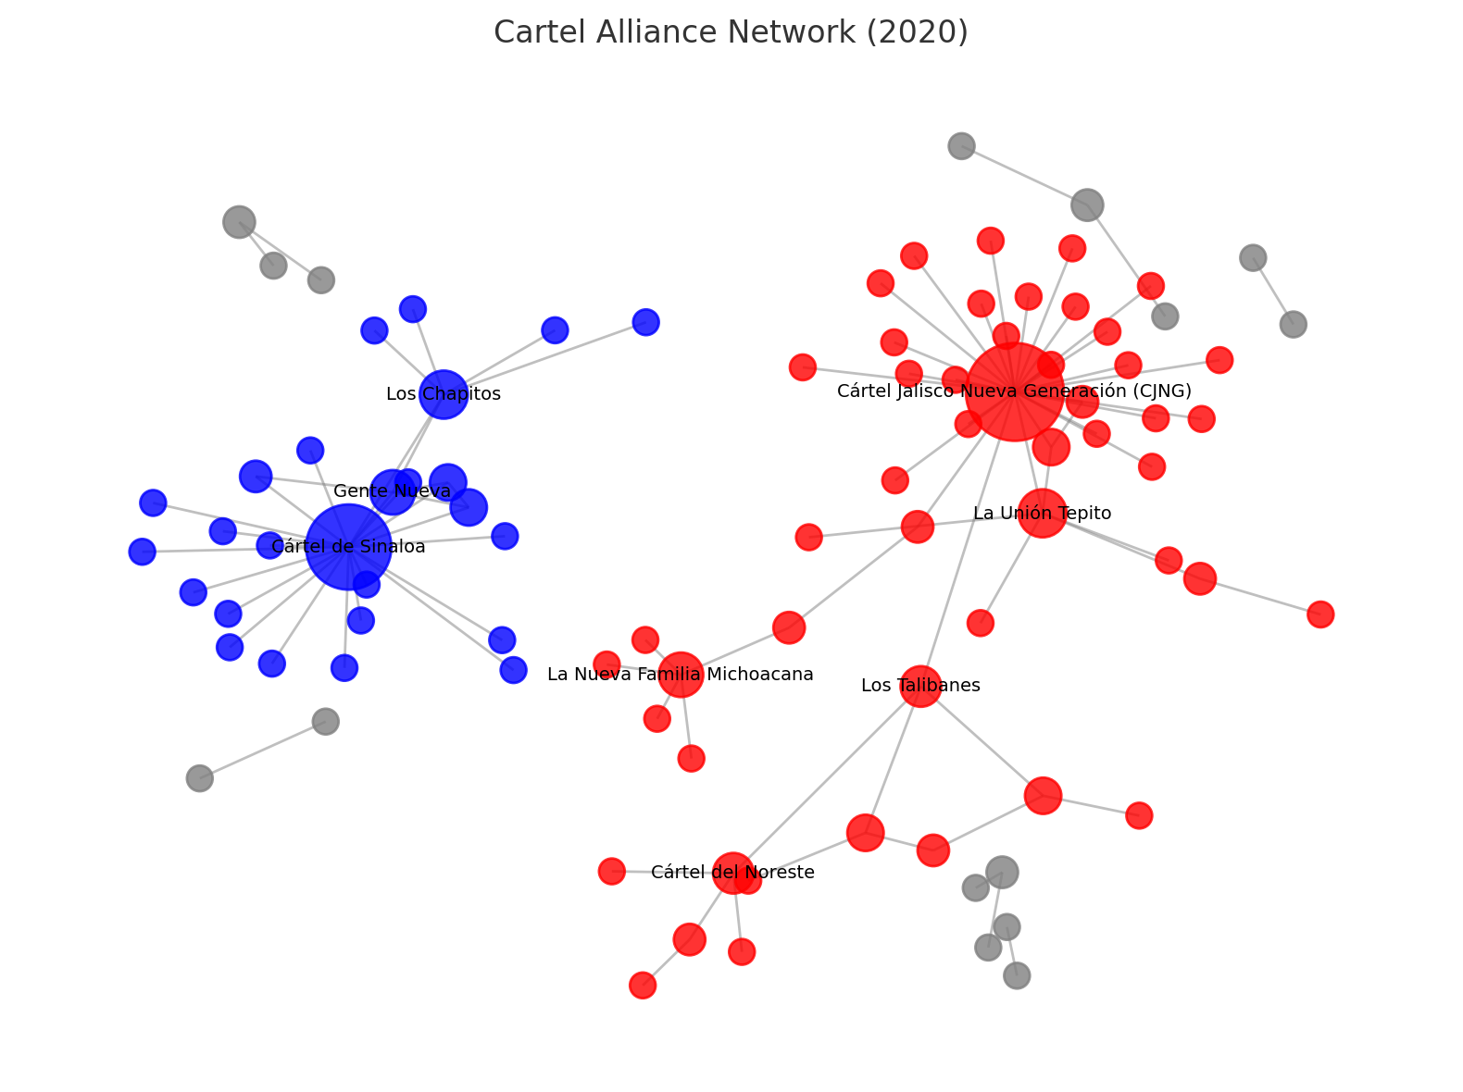
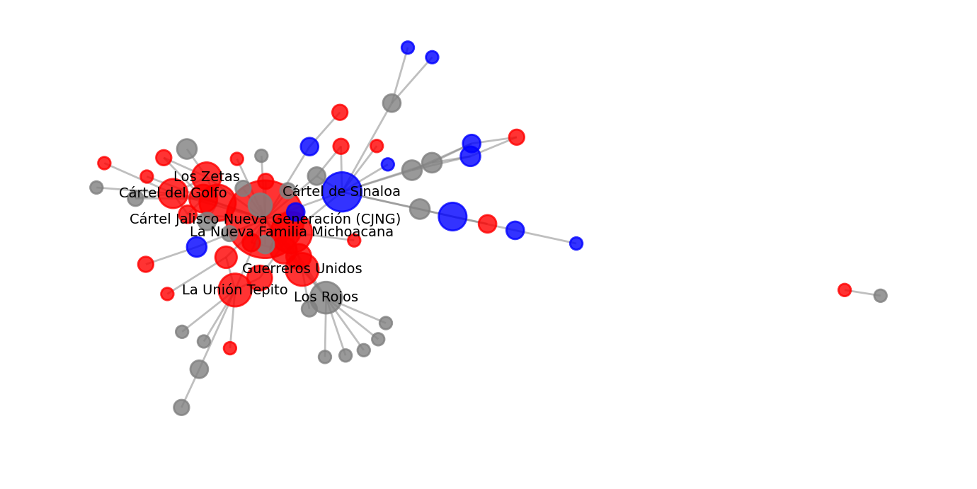
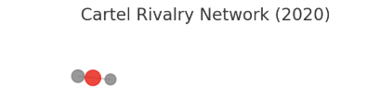
Overview of Networks
Alliances
Alliance Network: Fragmented, multiple clusters
CJNG & Sinaloa at the center of two main alliance blocs
Rivalry Network: Mostly one large component
CJNG involved in nearly every major conflict
Visualizations show conflict overlaps with alliances
Homophility/degree assortativity
Alliance: -0.4439783
Moderately disassortative
Rival: -0.23849
Moderately disassortative
Rivalries
Notes:
Connor Rodgers

Slide 4
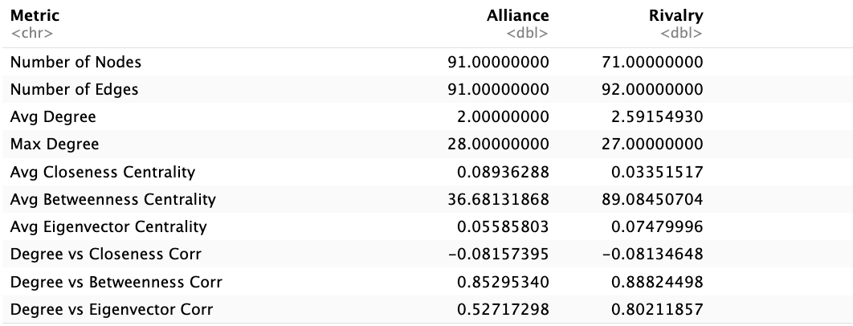
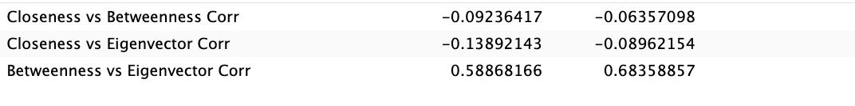
Centrality Analysis
Centrality Analysis
Key Takeaways:
Rivalries are more densely connected, suggesting frequent adversarial interactions between fewer cartels
Alliance Network:
Higher closeness centrality implies faster communication and higher influence across the network
Lower betweenness suggests fewer structural brokers, a likely decentralization of power
Rival Network:
High betweenness centrality signals key cartels acting as bridges in rivalries - potential power players or targets
Slightly higher eigenvector centrality suggests that influential cartels tend to rival other influential ones
Internetwork Takeaways:
Degree vs Betweenness: Stronger in Rivalry (0.88) means that high-degree nodes are also central brokers
Betweenness vs Eigenvector: Higher in Rivalry (0.68) than Alliance (0.59) means more overlap of influence and brokerage
Closeness correlations: Near-zero or negative means spatial reach is somewhat correlated to influence or brokerage in both

Slide 5
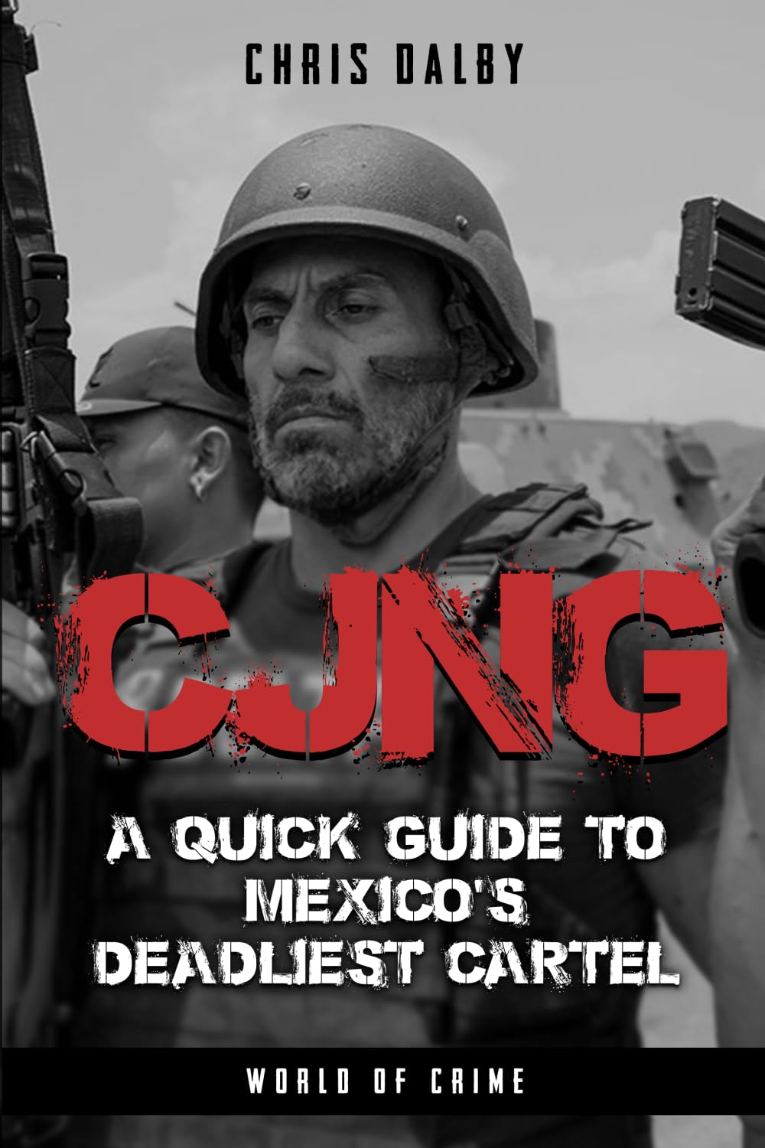
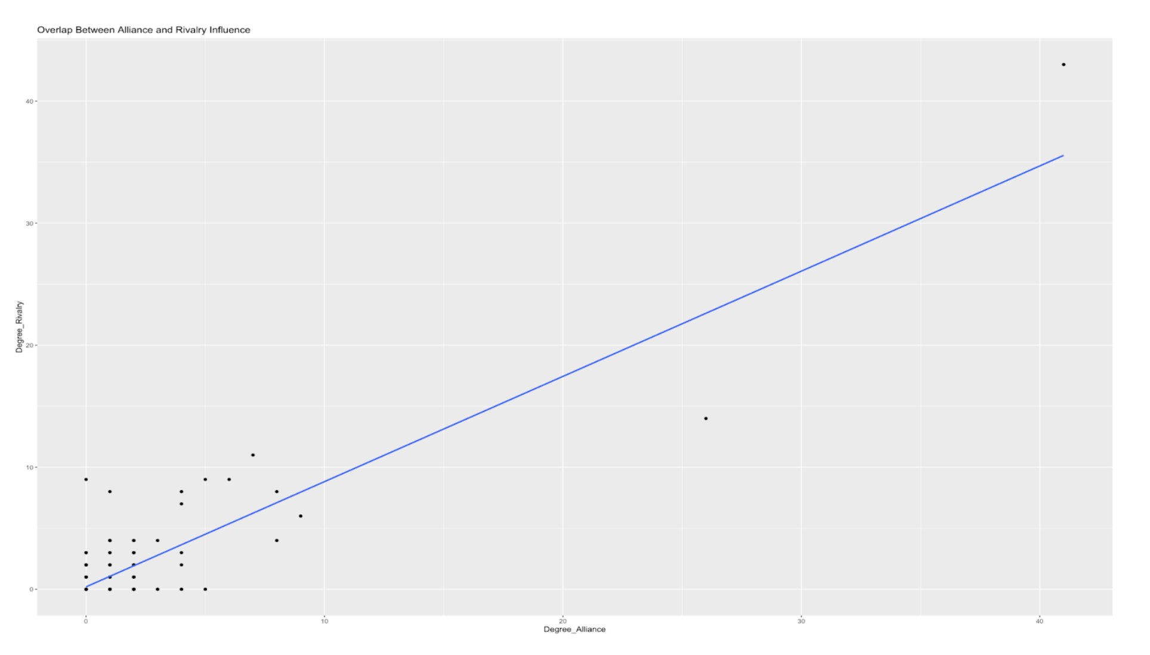
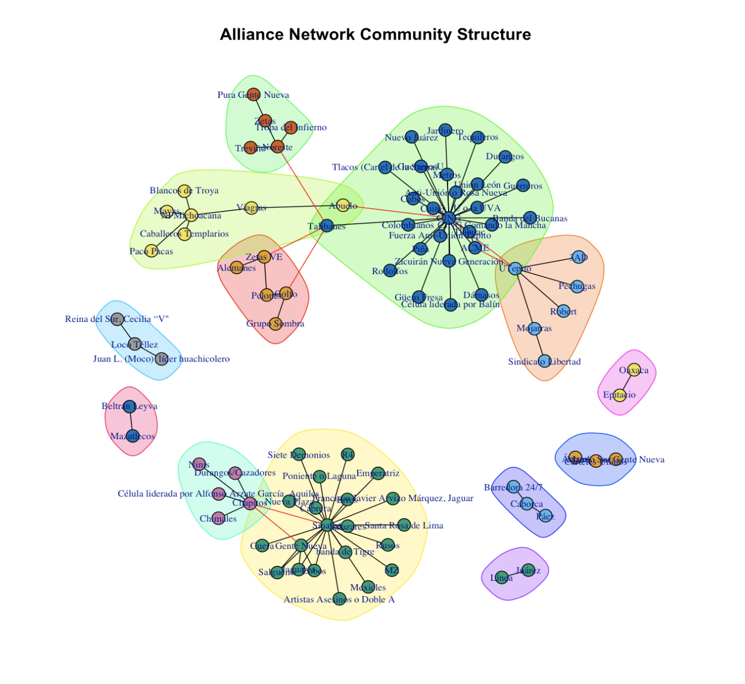
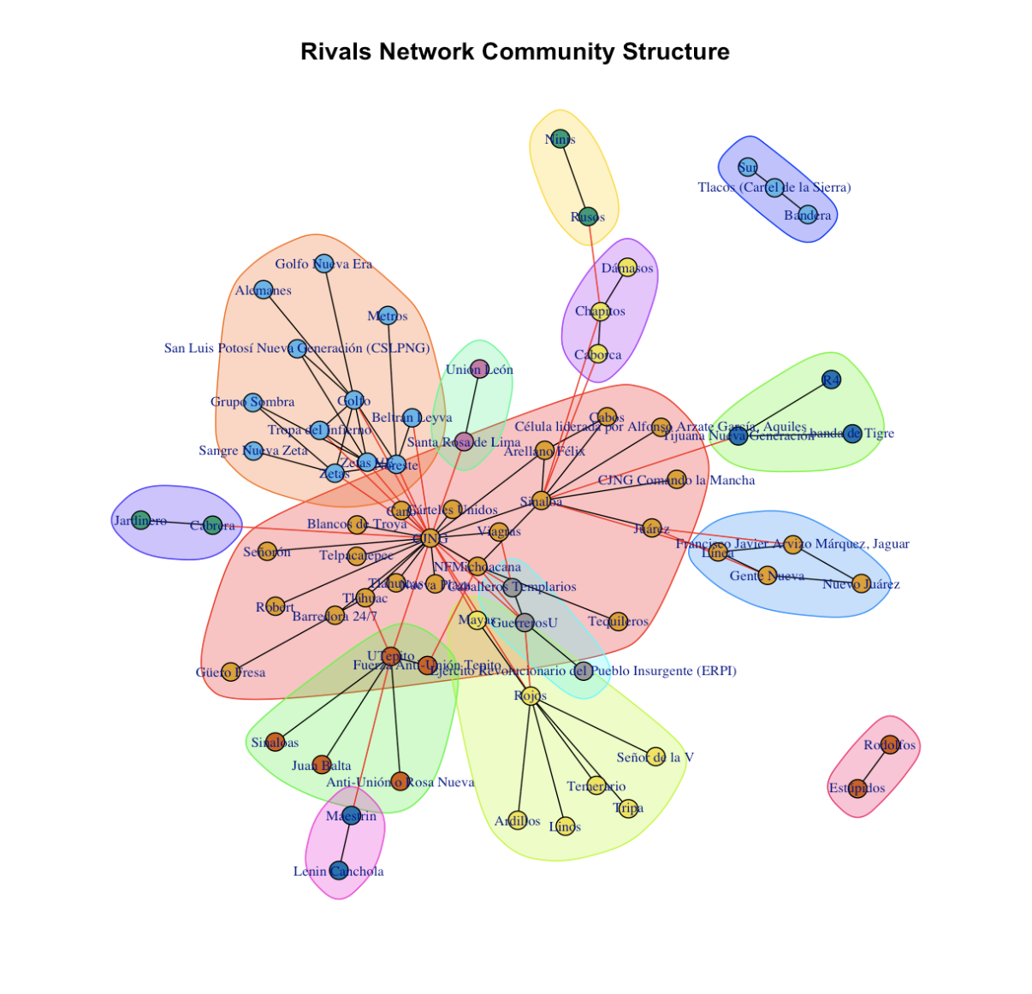
Subgroups/Communities
Key communities in alliance network:
CJNG-led coalition: alliances across 28 states
Sinaloa-led bloc: defensive posture, regional dominance
Rivalries mirror alliance communities
Conflicts mainly across communities, not within
13 Groups
11 Groups

Slide 6
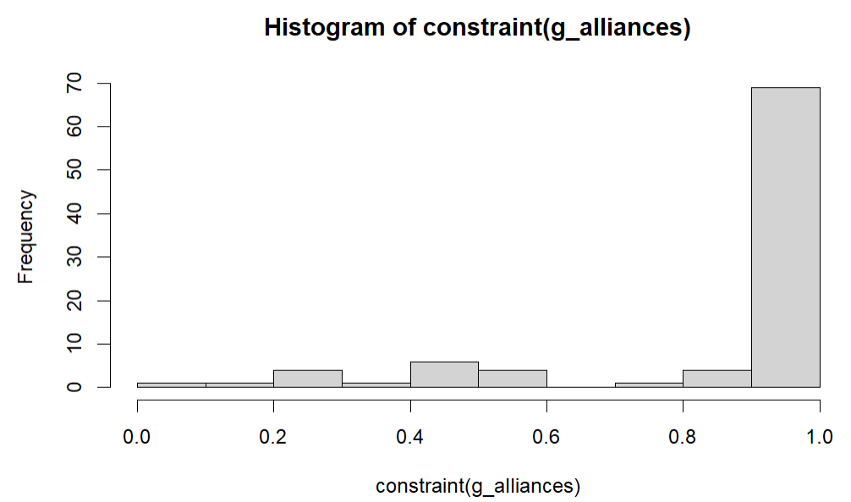
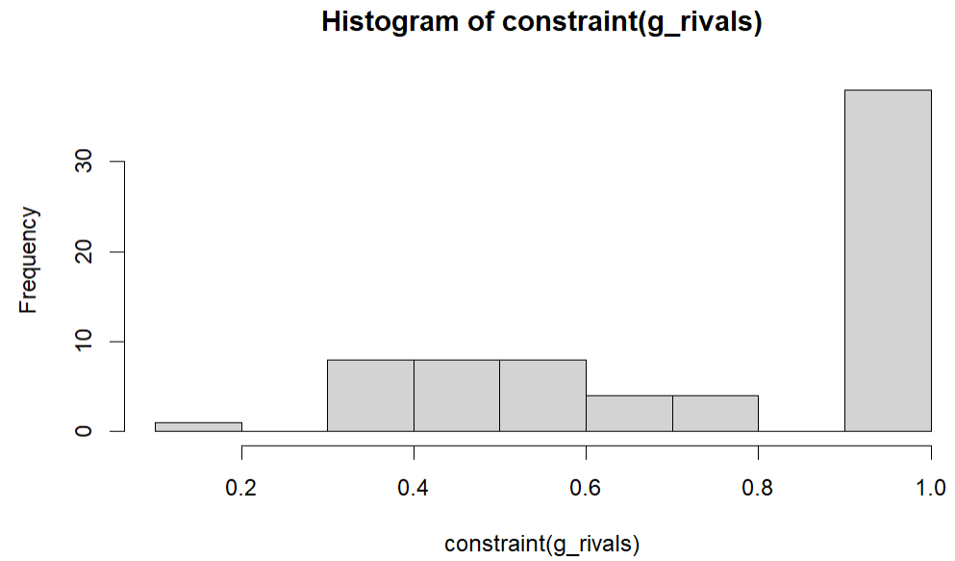
Social Capital–Constraint
Constraint
How “constrained” a node is by its neighbors
High value (1)→ Less opportunity to be a broker
Node’s connections are to more interconnected nodes
Low value (0) → More opportunity to be a broker
Node’s connections are to disconnected nodes
Values by network:
Mean constraint in alliance network: 0.876
Mean constraint in rival network: 0.771
Interpretation
Both networks have a high constraint, meaning that the average cartel tended to have redundant nodes, and not many cartels acted as information brokers.
Therefore this suggests that cartel relationships by both alliance and rivalries are very insulate–cartels tend to be grouped with nodes who already know each other.

Slide 7
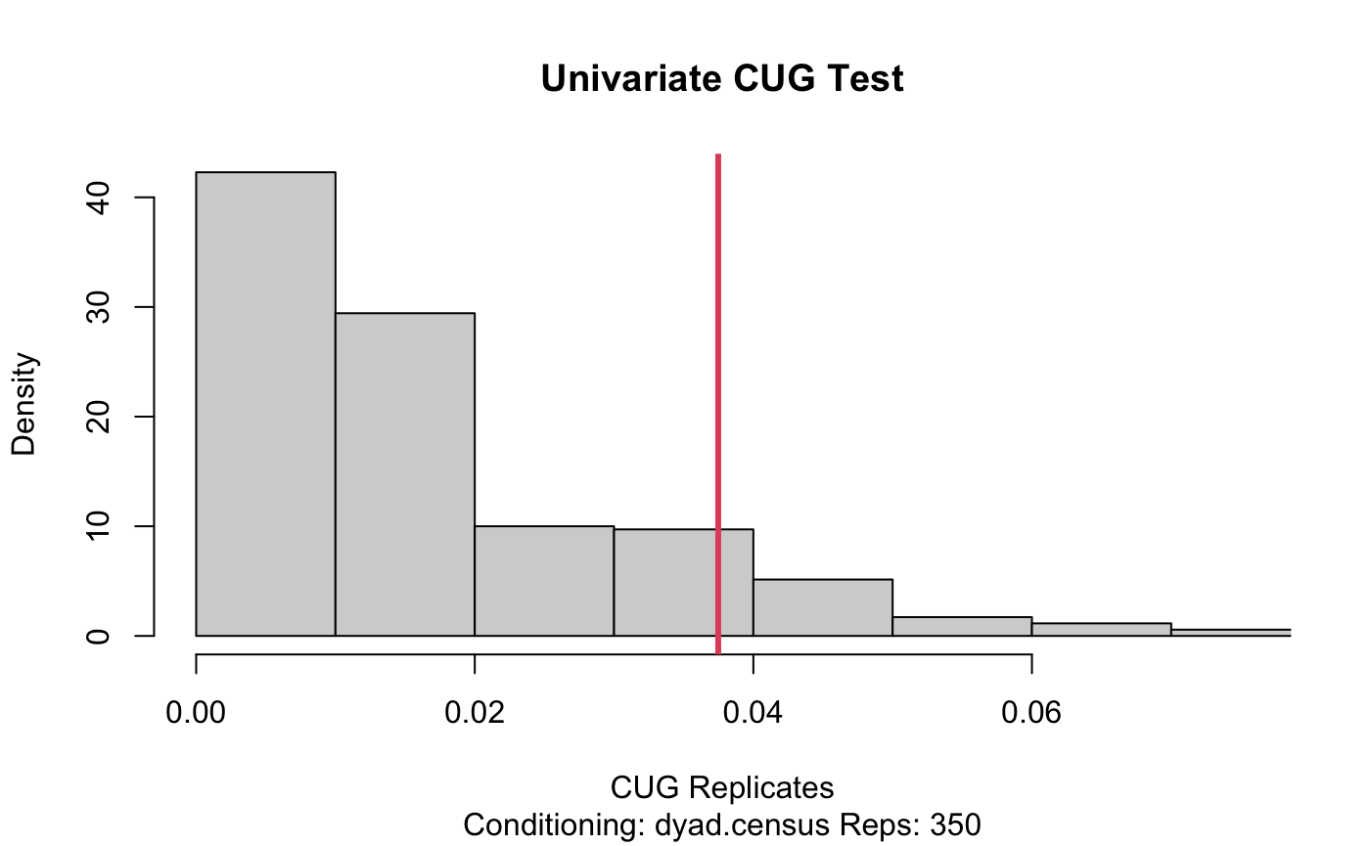
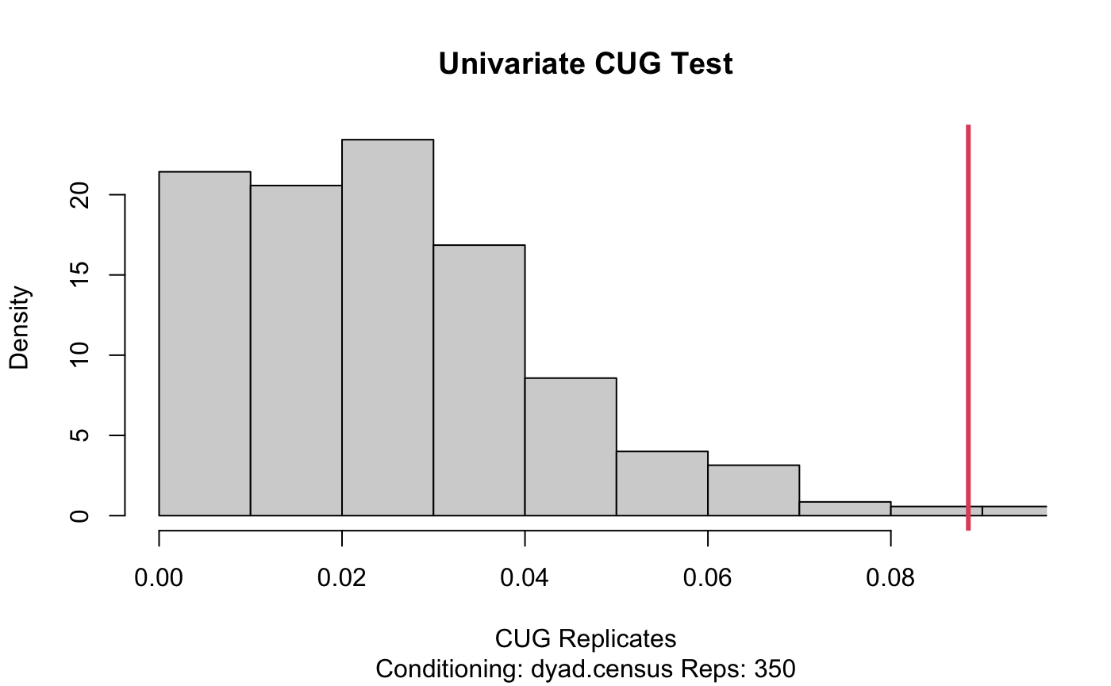
Social Capital-CUG test
Transitivity against Dyad Census
Transitivity values:
Alliances network: 0.03747871
Rivals network: 0.08846761
Interpretation:
Both networks show the higher transitivity than a random network, indicating that both networks contain the strong triadic closure.
The alliances network demonstrates a moderate level of clustering, suggesting alliances tend to form stable and cohesive groups through indirect ties.
The rivals network exhibits even stronger transitivity, implying tightly clustered opposition and shared enemy dynamics (“the enemy of my enemy is also my enemy”).
This contrast reflects different forms of social capital: cooperative cohesion vs. antagonistic alignment, highlighting stronger factional polarization in antagonistic relationships.

Slide 8
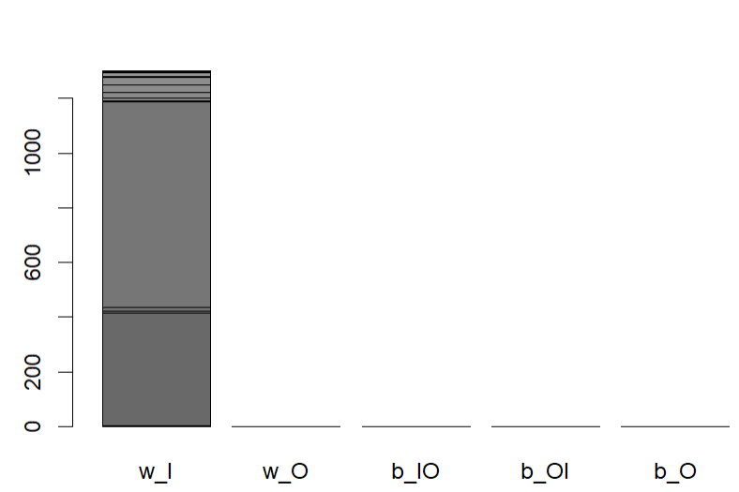
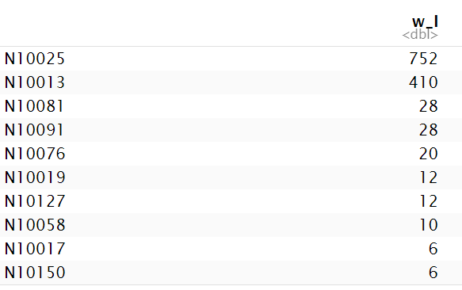
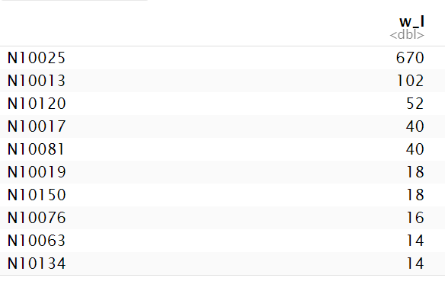
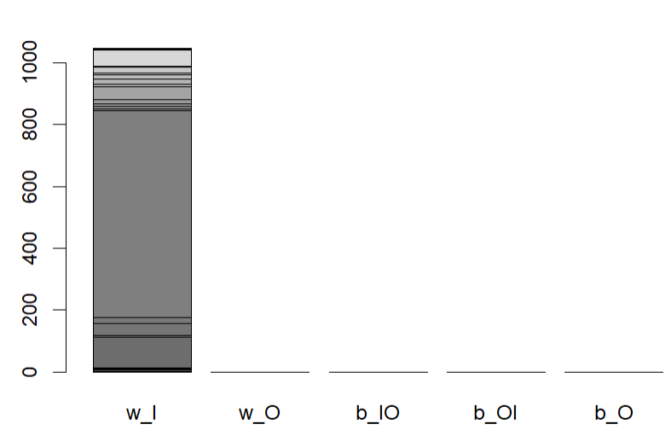
Social Capital–Brokerage
Brokerage
All nodes that were classified as brokers were coordinators (in both alliance and rival).
3 actors belonging to the same group with one actor brokering for the other two.
The cartel with the highest value for both alliance and rival was N10025, the CJNG.
752, and 670 respectively
The cartel with the 2nd highest value for the two networks was N10013, Cártel de Sinaloa.
410 and 102 respectively
Overall, this implies that the CJNG cartel was the most dominant cartel in the data, with it being relied on for information in alliances, and also being involved in the most rivalries between cartels.
Supports idea of high rivalry and high alliances
Alliance Brokerage
Rivalry Brokerage

Slide 9
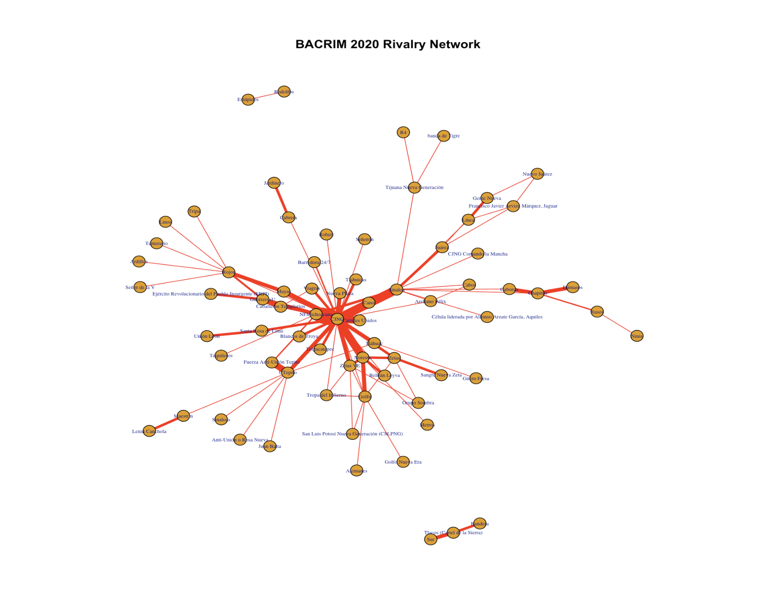
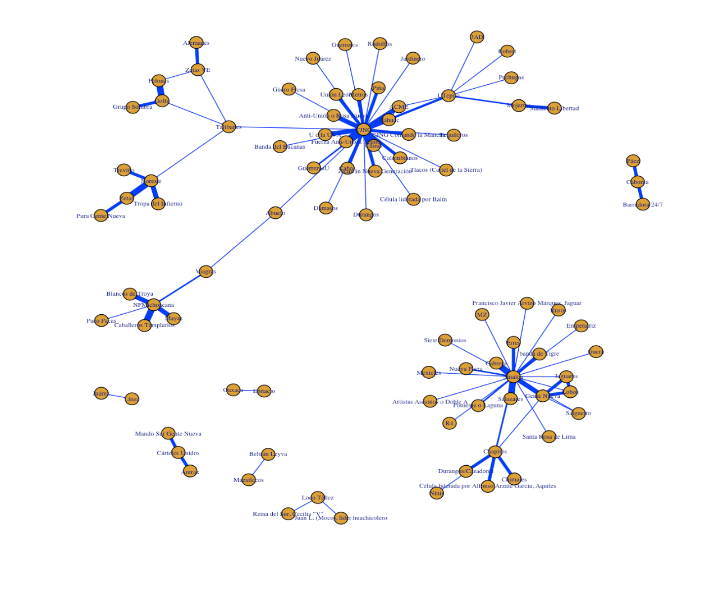
Actionable Insights
Monitor Cartels with Broad Influence
Cartels such as CJNG and Sinaloa are structurally positioned to act as connective hubs in the network, making them critical to:
Detecting shifting alliances
Monitoring territorial expansion
Anticipating power shifts
Predictive Indicators for Violence
Network metrics help identify early signs of conflict escalation and cartel destabilization in the rivalry network:
An increase in degree/betweenness centrality
An increase in eigenvector centrality
An increase in transitivity
Understanding “The Enemy of My Enemy” Logic
Cartels often align indirectly through shared enemies, creating polarized opposition blocs.
Keeping an eye on transitivity in the rival network allows us to target tightly clustered enemy groups, which tend to be more aggressive and unstable.

Slide 10
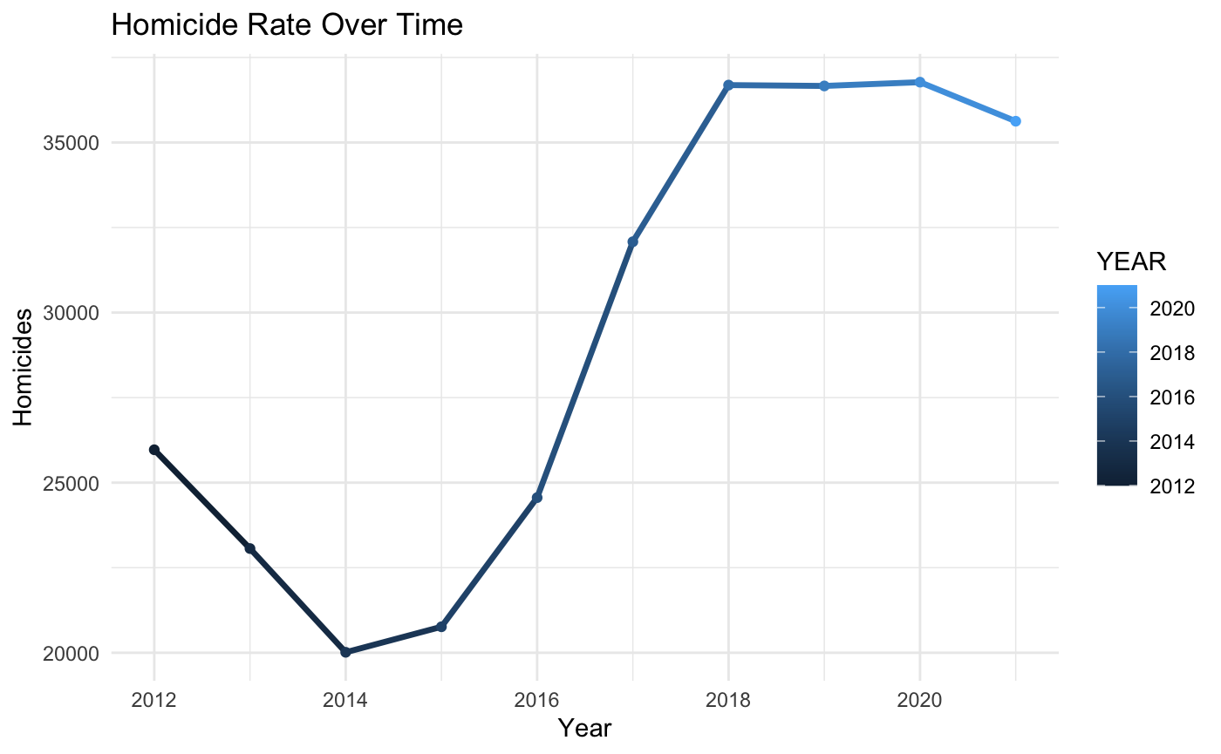
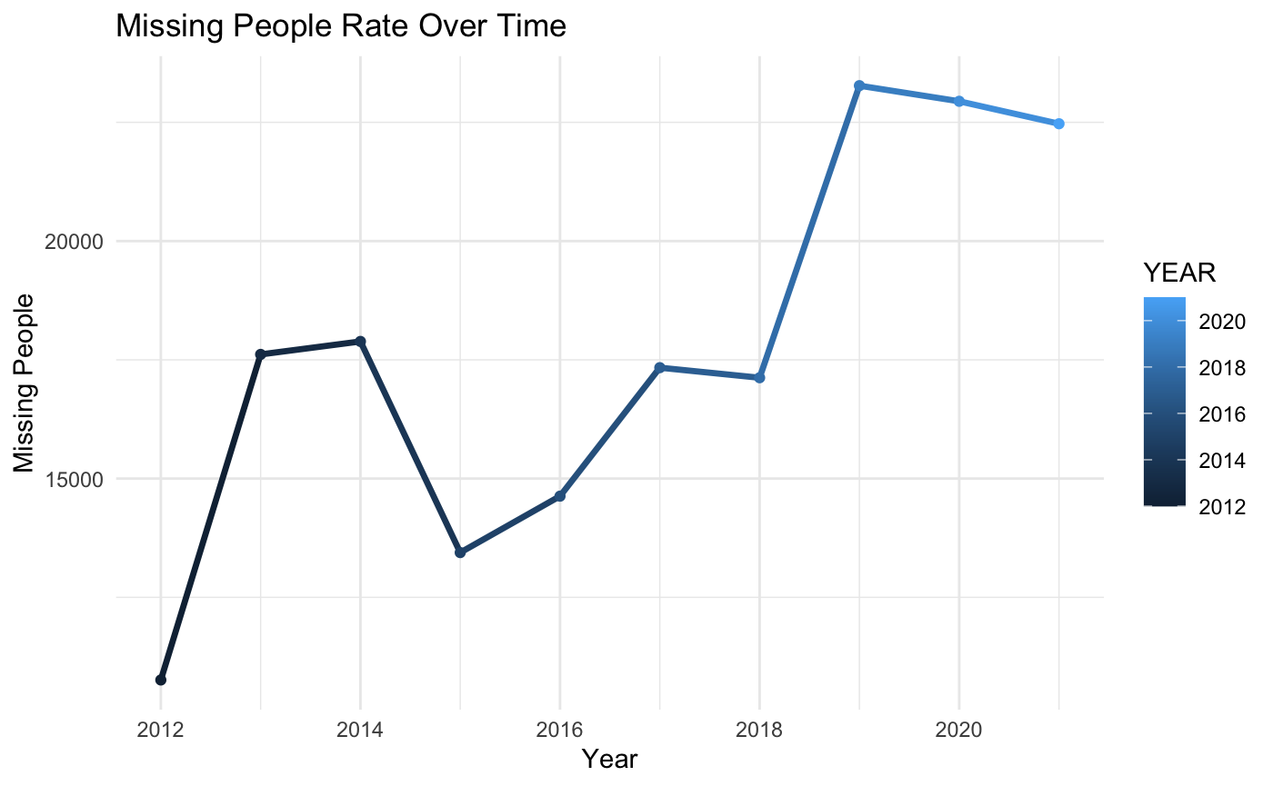
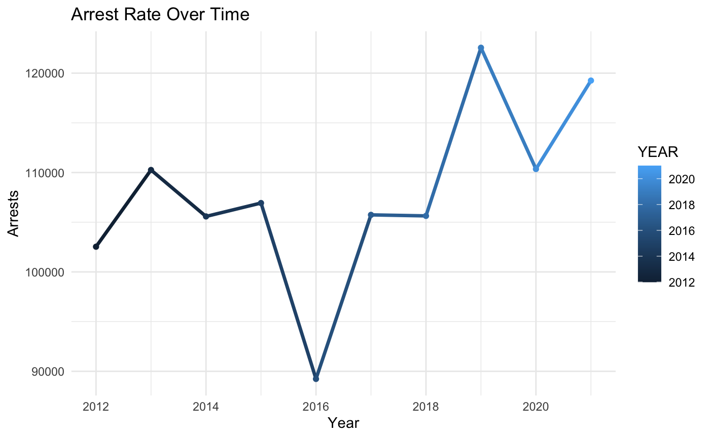
Why Is This Important?
The homicide rate has a sharp increase from 2014-2018 and has remained at the high end since. This tells us that cartel violence continues to be an issue, and studying their social structure could provide helpful insights into the source of the violence. The number of missing people has also increased over time, even though the growth rate is less consistent. However, the least steady is the arrest rate over time, these sharp rises and falls in the graph tell us that law enforcement has not been able to consistently keep up with cartel-related violence.
This is important to understand and study because if we can understand cartel movements and structure we can get a better understanding of how they work. Once the cartel structures are understood we will have the necessary tools for law enforcement to address them and keep communities safe.

Slide 11
Thank You!

